Slide 1
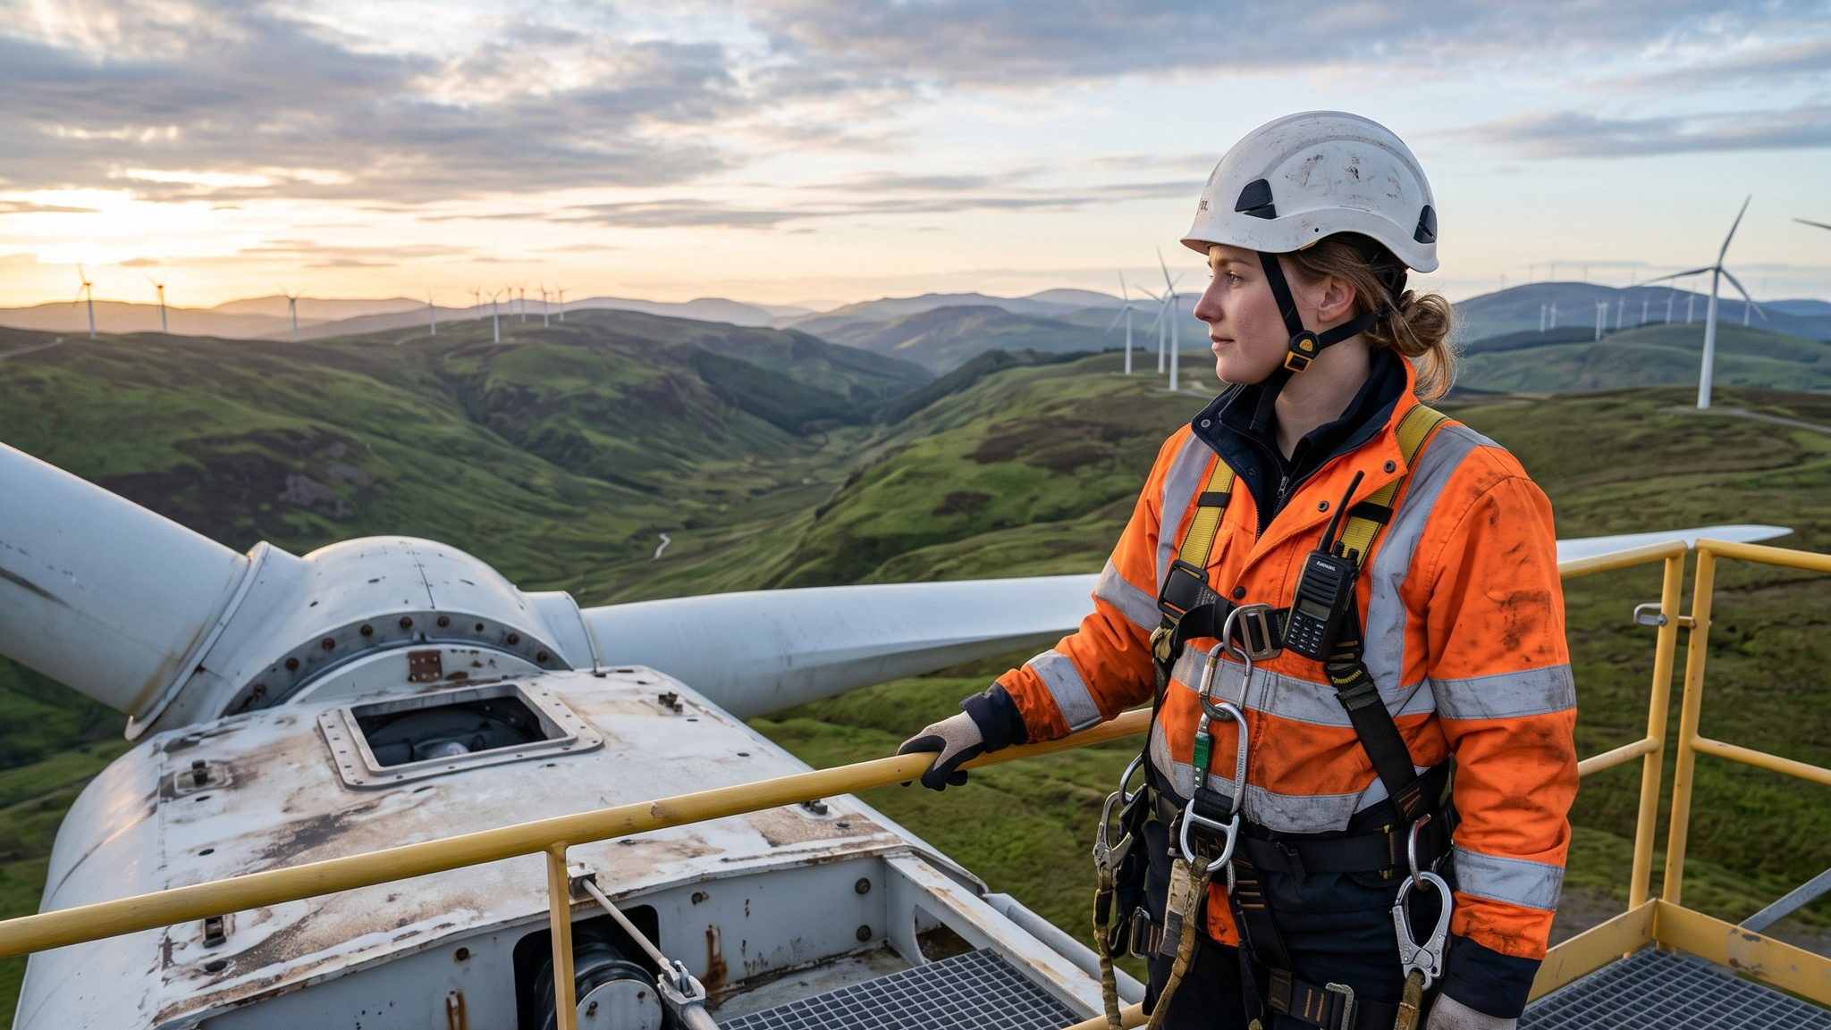
WEYLAND ENERGY
Annual Report 2025
Option A – technician on the nacelle

Slide 2
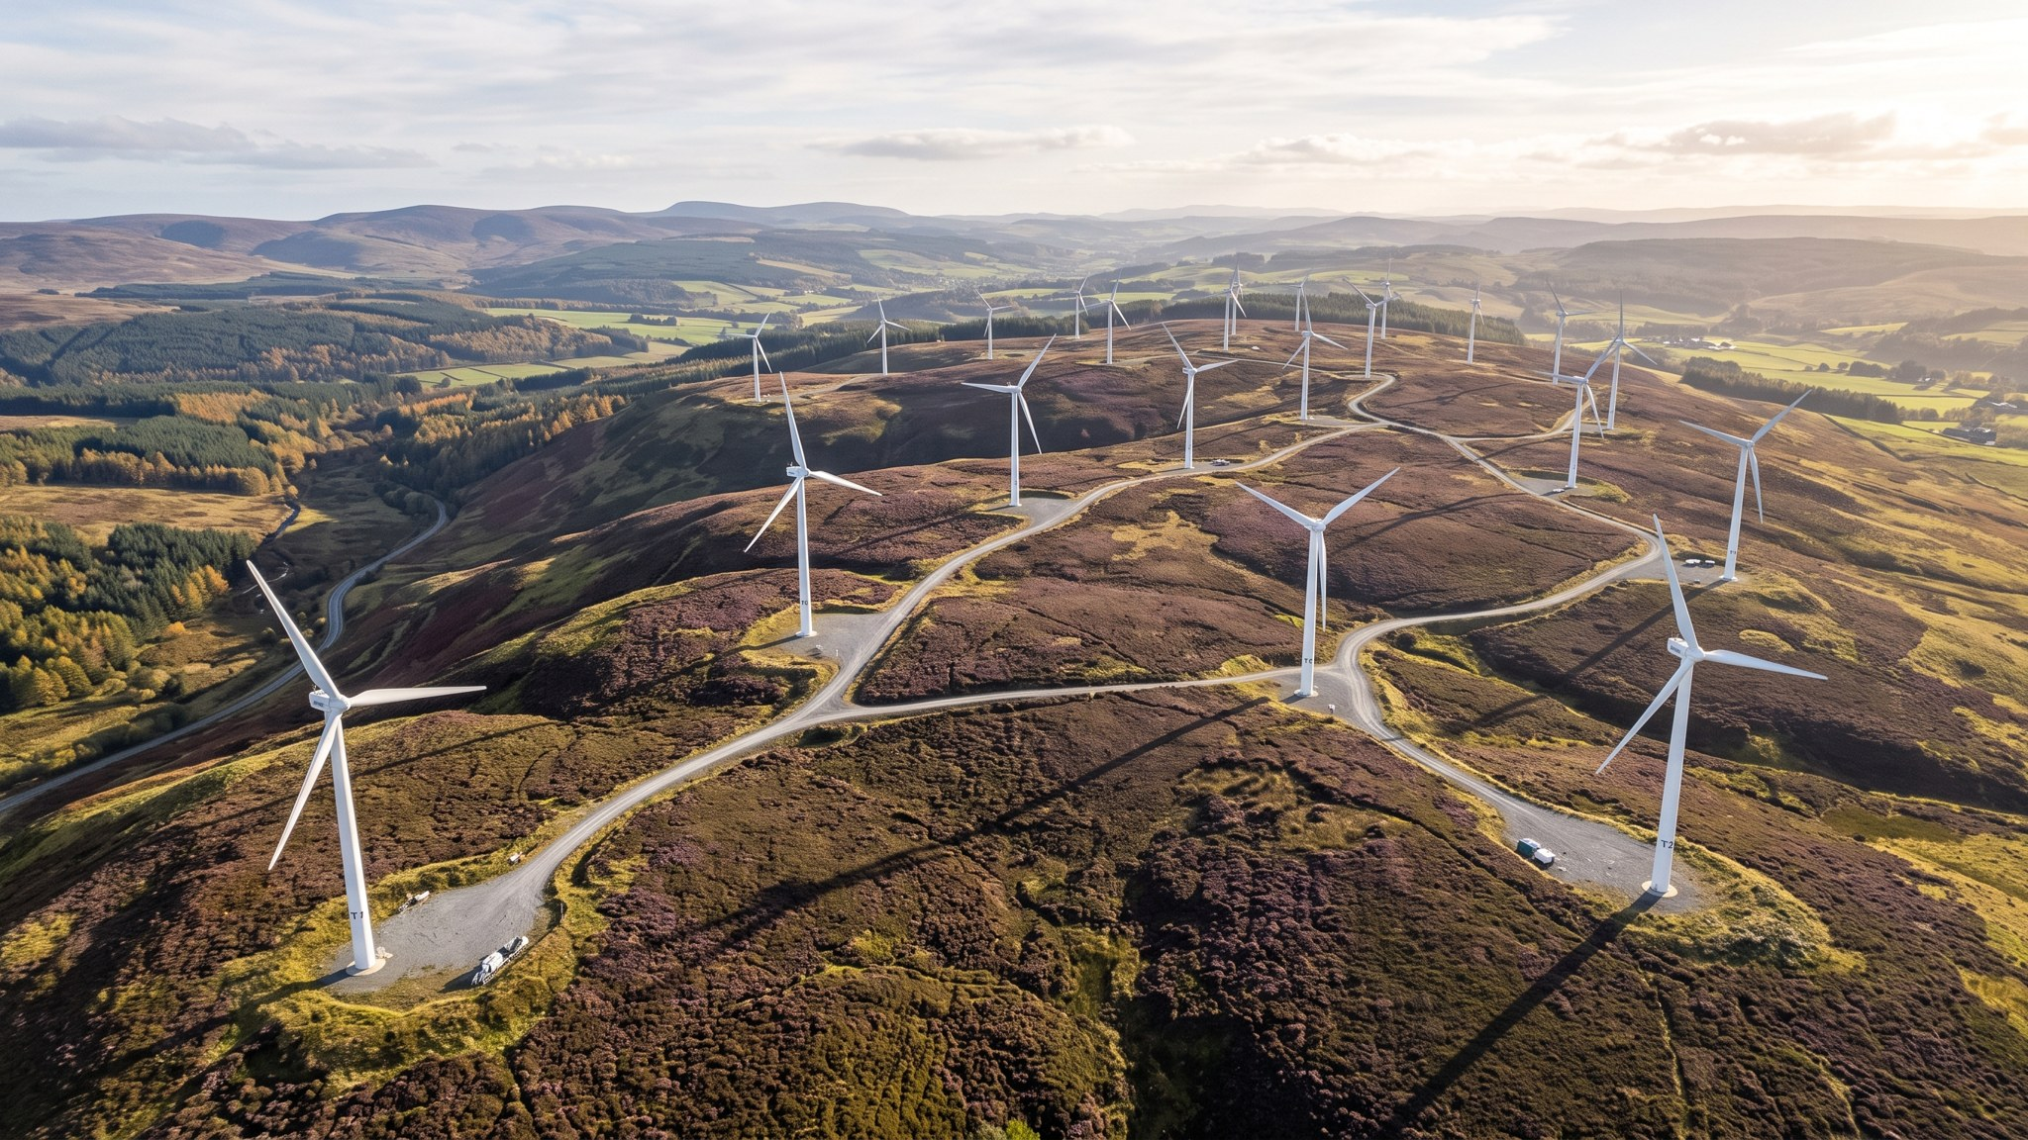
WEYLAND ENERGY
Annual Report 2025
Option B – Kestrel Ridge from above

Slide 3
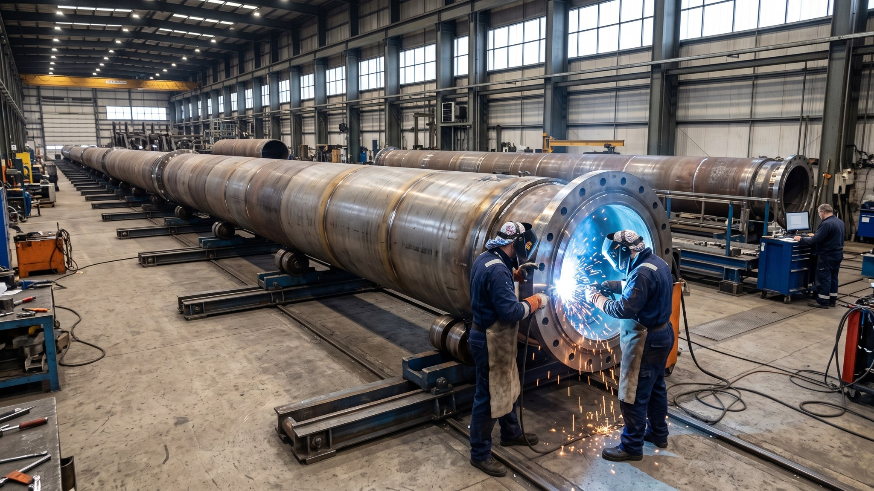
WEYLAND ENERGY
Annual Report 2025
Option C – monopiles waiting for Harrow Bay

Slide 4
Recommendation
• Option A: people + scale, fits "built to last"
• Option B: strong but similar to AR 2024
• Option C: Harrow Bay story – but nothing installed yet in 2025
WEYLAND ENERGY · Annual Report 2025 – Cover Options
4
Notes:
Jonas and Amara chose option A on 23 January.

Slide 5
Typography and colours
• Arial throughout, headlines Deep Sea #0B3C5D
• Accent Teal #1FA2A6, charts Sun #F2B134
• Grid: 12 columns, A4 portrait
• Accessible PDF (PDF/UA)
WEYLAND ENERGY · Annual Report 2025 – Cover Options
5

Slide 6
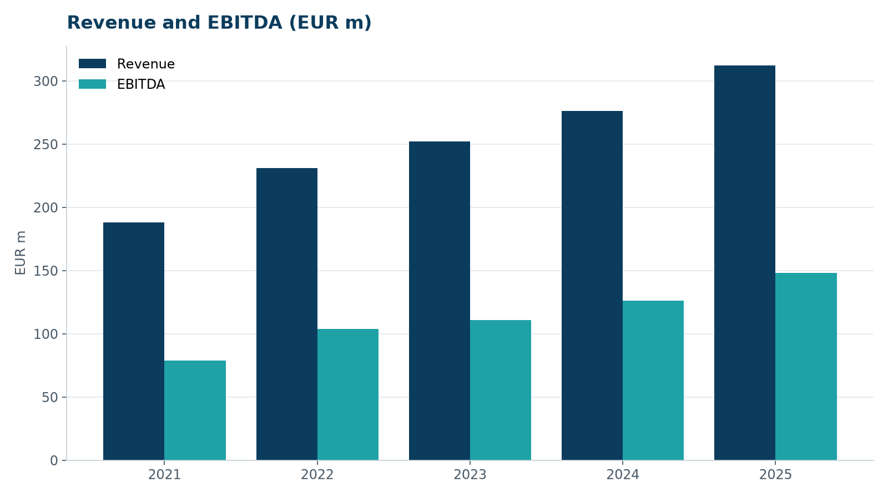
Chart style
• Flat bars, no 3D
• Values on bars
• Prior year in grey
WEYLAND ENERGY · Annual Report 2025 – Cover Options
6

